Slide 1
Unified Digital Format Registry (UDFR) Understanding the System and Service
International Internet Preservation Consortium (IIPC) General Assembly
Library of Congress, April 30 – May 4, 2012
Stephen Abrams
Lisa Dawn Colvin
Abhishek Salve
UC Curation Center
California Digital Library
http://www.cdlib.org/uc3

Slide 2
Agenda
 | Time | Topic
 | 09:00 – 09.10 | Introductions and review of goals
 | 09:10 – 09:30 | Background on the UDFR project
 | 09:30 – 10:00 | Demonstration of main features
 | 10:00 – 10:30 | Technology stack and architecture
 | 10:30 – 10:45 | Break
 | 10:45 – 11:45 | Code walk-through
 | 11:45 – 12:00 | Questions and discussion
 | 12:00 – 13:00 | Lunch
 | 13:00 – 13:45 | Ontological models
 | 13:45 – 14:15 | Administrative procedures
 | 14:15 – 14:45 | Community building and next steps
 | 14:45 – 15:00 | Questions and discussion

Slide 3
Goals
Understanding the UDFR architecture
Understanding the UDFR ontological modeling
Understanding the UDFR administrative procedures
Tangible next steps for facilitating ongoing community engagement and support

Slide 4
Agenda
 | Time | Topic
✓ | 09:00 – 09.10 | Introductions and review of goals
 | 09:10 – 09:30 | Background on the UDFR project
 | 09:30 – 10:00 | Demonstration of main features
 | 10:00 – 10:30 | Technology stack and architecture
 | 10:30 – 10:45 | Break
 | 10:45 – 11:45 | Code walk-through
 | 11:45 – 12:00 | Questions and discussion
 | 12:00 – 13:00 | Lunch
 | 13:00 – 13:45 | Ontological models
 | 13:45 – 14:15 | Administrative procedures
 | 14:15 – 14:45 | Community building and next steps
 | 14:45 – 15:00 | Questions and discussion

Slide 5
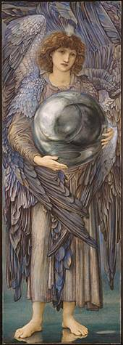
Why formats?
“Format” is the dividing line between bits and information
ffd8ffe000104a46
4946000102010083
00830000ffed0fb0
50686f746f73686f
7020332e30003842
494d03e90a507269
6e7420496e666f00
0000007800000000
0048004800000000
02f40240ffeeffee
0306025203470528
03fc000200000048
00480000000002d8
0228000100000064
0000000100030...
SOI
APP0 JFIF 1.2
APP13 IPTC
APP2 ICC
DQT
SOF0 183x512
DRI
DHT
SOS
ECS0
RST0
ECS1
RST1
ECS2
...
Notes:
Edward Burne-Jones (British, 1833-1898)
The Days of Creation: the First Day, 1870-1876
Watercolor and gouache, 102.2×35.5 cm
Fogg Art Museum, Harvard University, 1943.454
Bequest of Grenville L. Winthrop

Slide 6
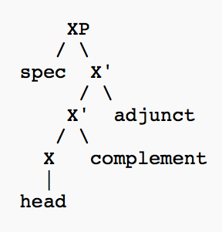
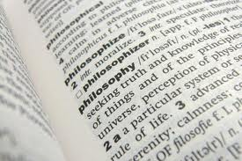
Why formats?
There are many necessary preservation activities that can be usefully performed on bits qua bits
to preserve information you most act on formatted bits and know what those formats represent
Preservation of content syntax and semantics
(both the structure and meaning of the digital representation)

Slide 7

Unified Digital Format Registry
“A reliable, publicly accessible, and sustainable knowledge base of file format representation information for use by the digital preservation community”
http://udfr.org/
udfr-l@listserv.ucop.edu
“Unification” of the function and holdings of PRONOM and GDFR
http://www.nationalarchives.gov.uk/PRONOM
http://gdfr.info/
Open source platform / GPL
Semantic wiki
Funded by the Library of Congress

Slide 8



A bit of history …
PRONOM – National Archives [UK], 2002
http://www.nationalarchives.gov.uk/PRONOM
“ready access to reliable technical information about the nature of electronic records”
JHOVE – Harvard, 2003
http://hul.harvard.edu/jhove
“digital object validation and characterization”
Global Digital Format Registry (GDFR) –
Harvard/OCLC, 2006
http://gdfr.info/
“a distributed and replicated registry of format information populated and vetted by experts and enthusiasts world-wide”

Slide 9


A bit of history …
Proto-UDFR – Ad hoc stakeholder community, 2009
Resolve PRONOM IPR issues and develop a community-supported open source solution
Advance beyond legacy RDBMS (PRONOM) and XMLDB (GDFR) technology
UDFR – CDL, January 2011
http://udfr.org/
udfr-l@listserv.ucop.edu
“a semantic registry for digital preservation”
LC/NDIIPP funded
Stakeholder meeting 2011
Beta release, November 2011
Production release, May 2012

Slide 10

Representation information
What you need to know about something in order to exploit that thing meaningfully [OAIS/ISO 14720]
Information that lets you answer important preservation questions (directly or indirectly)
What format is it?
What are its significant properties?
Is it valid?
Is it at risk?
How can I render/play/read it?
What can it be transformed into?

Slide 11

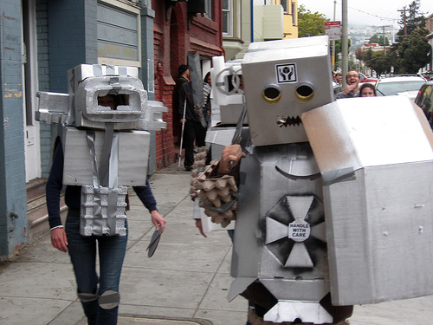
Why semantic?
The semantic web lets anyone say anything about anything
Understandable to both people and machines
The web is (or soon will be) a semantic web
Linked Data interoperability
http://linkeddata.org/
Notes:
Shout! – Mark Wheadon, http://www.flickr.com/photos/mark_wheadon/2557902153
Robots! – Jere Keys, http://www.flickr.com/photos/tyreseus/527207577

Slide 12
Why semantic?
Triples all the way down…
Data expressed as triples
Data definition (i.e., ontology) expressed as triples
Ontology definition expressed as triples
Facilitates self-configuration and easy extension

Slide 13
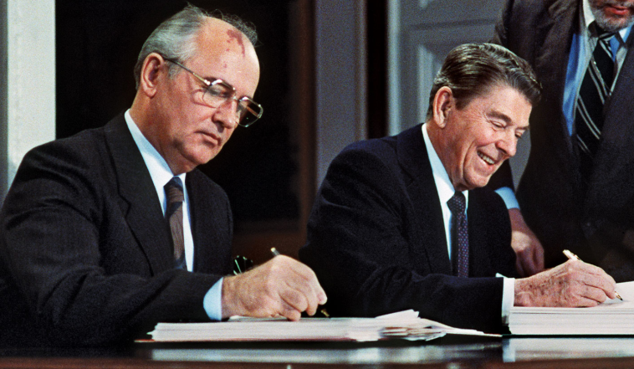
Provenance
“Trust, but verify”
Complete change history at the assertion level
Who made the assertion, and when
Confidence based on institutional reputation
Imprimatur of technically knowledgeable reviewers
Notes:
Gorbachev and Reagan -- AFP/Getty Images, http://www.britannica.com/bps/media-view/121436/1/0/0

Slide 14

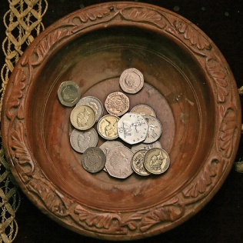


Roles
Consumer Anonymous read
Contributor Read + write
Reviewer Read + write + review
Administrator Read + write + review + administer
Notes:
Shopping cart -- http://www.flickr.com/photos/tjmartins/3889307169
Collection plate -- http://www.flickr.com/photos/lwr/166988094

Slide 15
Initial data loads
MIME types from Appspot as of 2012-02-22
http://mediatypes.appspot.com/
“Routinely scrapped from IANA using code in the mediatypes Google Code project”
809 application/*
125 audio/*
39 image/*
19 message/*
14 model/*
14 multipart/*
51 text/*
56 video/*
1,127
Plus 71 defined by PRONOM

Slide 16
Initial data loads
PRONOM as of 2012-02-21
http://www.nationalarchives.gov.uk/PRONOM
846 file formats
28 character encodings
17 compression algorithms
1,237 identifiers
1,006 external signatures
494 internal signatures
71 MIME types (not in Appspot)
156 agents
268 software packages
2,080 software processes
23 IPR statements
217 relationships
8,274
Special thanks to TNA
Spencer Ross
Tracey Powell
Tim Gollins

Slide 17
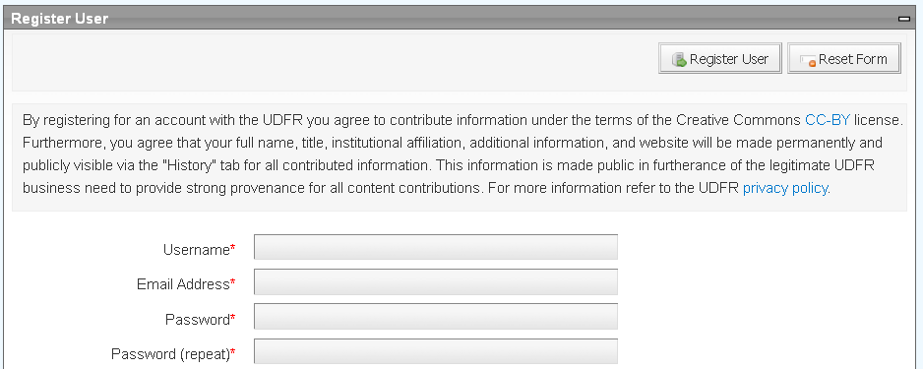
Data licensing
PRONOM data contributed under UK Open Government License (OGL)
http://www.nationalarchives.gov.uk/doc/open-government-licence/
Other submissions contributed under under Creative Commons Attribution license (CC-BY)
http://creativecommons.org/licenses/by/3.0/

Slide 18
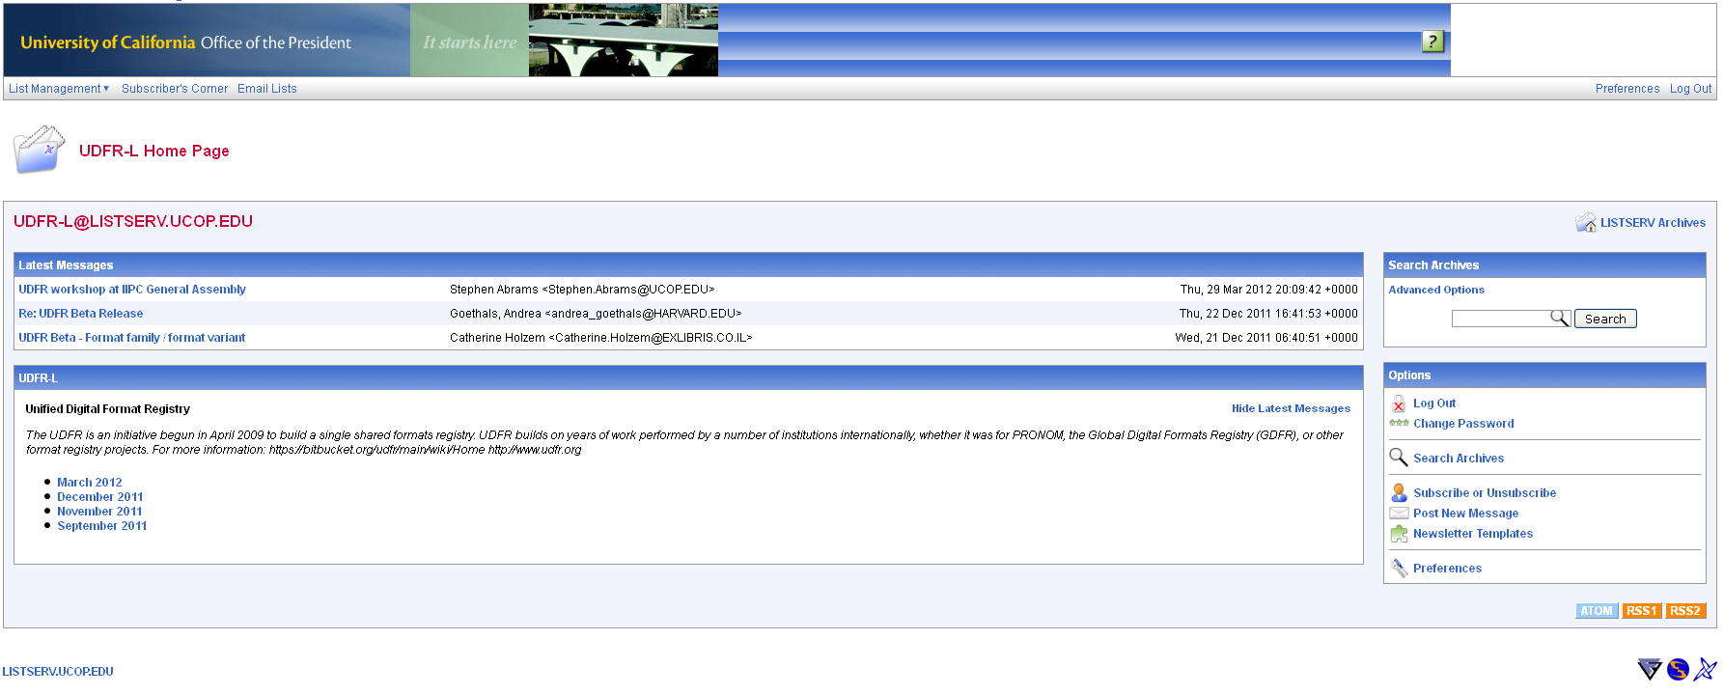
Communication
UDFR listserv
udfr-l@listserv.ucop.edu
http://listserv.ucop.edu/cgi-bin/wa.exe?A0=UDFR-L
To subscribe, send “SUB UDFR-L <name>” to listserv@ucop.edu

Slide 19
Agenda
 | Time | Topic
✓ | 09:00 – 09.10 | Introductions and review of goals
✓ | 09:10 – 09:30 | Background on the UDFR project
 | 09:30 – 10:00 | Demonstration of main features
 | 10:00 – 10:30 | Technology stack and architecture
 | 10:30 – 10:45 | Break
 | 10:45 – 11:45 | Code walk-through
 | 11:45 – 12:00 | Questions and discussion
 | 12:00 – 13:00 | Lunch
 | 13:00 – 13:45 | Ontological models
 | 13:45 – 14:15 | Administrative procedures
 | 14:15 – 14:45 | Community building and next steps
 | 14:45 – 15:00 | Questions and discussion

Slide 20
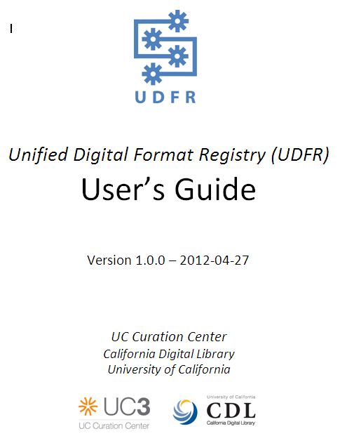
User’s Guide
http://udfr.org/docs/UDFR-Users-Guide-v1.0.0.pdf

Slide 21
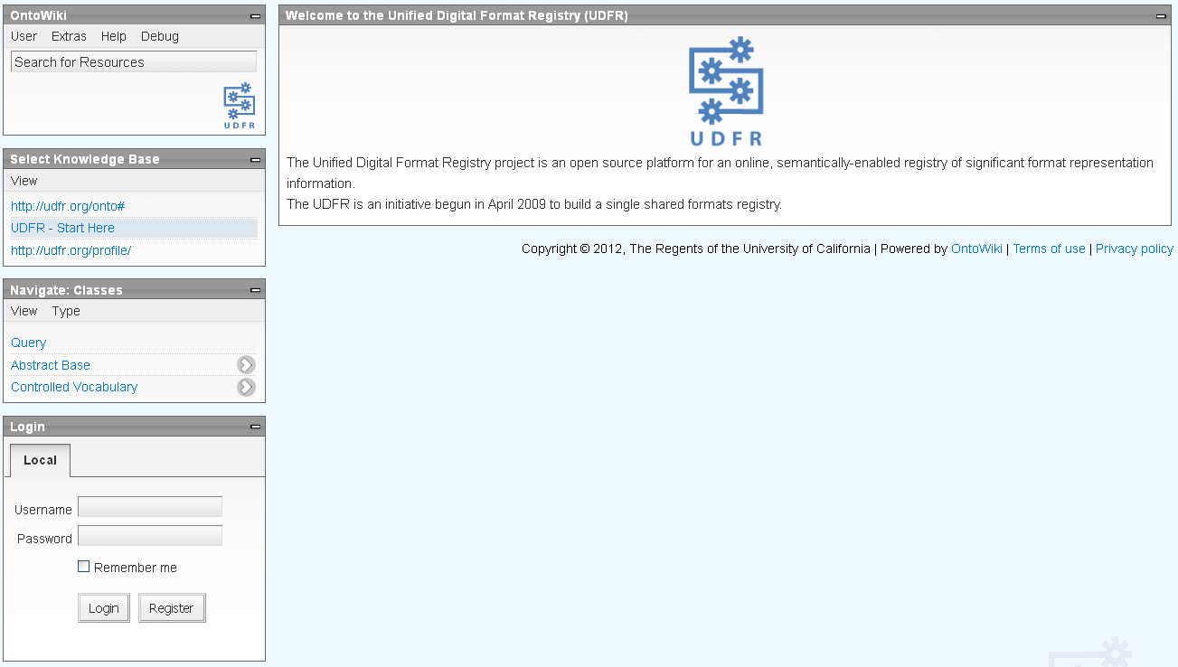
UI layout
Workspace pane
Function dependent
OntoWiki pane
Register/login/logout
SPARQL query form
Documentation
Session reset
Knowledge base pane
Ontology browser pane
Register/login pane
http://udfr.org/

Slide 22
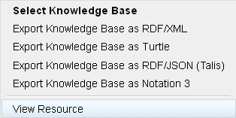
Contextual menus
Contextual menu
http://udfr.org/

Slide 23
Demonstration
http://udfr.org/

Slide 24
Agenda
 | Time | Topic
✓ | 09:00 – 09.10 | Introductions and review of goals
✓ | 09:10 – 09:30 | Background on the UDFR project
✓ | 09:30 – 10:00 | Demonstration of main features
 | 10:00 – 10:30 | Technology stack and architecture
 | 10:30 – 10:45 | Break
 | 10:45 – 11:45 | Code walk-through
 | 11:45 – 12:00 | Questions and discussion
 | 12:00 – 13:00 | Lunch
 | 13:00 – 13:45 | Ontological models
 | 13:45 – 14:15 | Administrative procedures
 | 14:15 – 14:45 | Community building and next steps
 | 14:45 – 15:00 | Questions and discussion

Slide 25
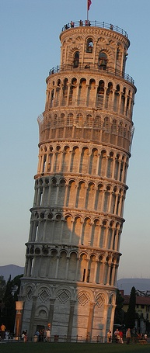
Technology stack
Apache httpd
http://httpd.apache.org/
HTTP / SPARQL
http://www.w3.org/TR/rdf-sparql-query
RDFauthor/JavaScript
http://aksw.org/Projects/RDFauthor
Noid
http://wiki.ucop.edu/display/Curation/NOID
OntoWiki
http://ontowiki.net/
Erfurt API
http://aksw.org/Projects/Erfurt
Zend framework
http://framework.zend.com/
Virtuoso quadstore
http://virtuoso.openlinksw.com/
PHP
http://www.php.net/
RDF
http://www.w3.org/RDF
Notes:
Leaning Tower of Pisa – Stephen and Claire Farnsworth, http://www.flickr.com/photos/the_farnsworths/2623592483

Slide 26
OntoWiki
Model-driven semantic wiki
http://ontowiki.net/
Agile Knowledge Engineering and Semantic Web research group (ASKW), Universität Leipzig
http://aksw.org/
DBpedia
http://www.dbpedia.org/
Key technology in EU-funded Linked Open Data (LOD2) project
http://lod2.eu/
Fully-featured semantic wiki facilitating user contributed content
Modifications necessary to enforce adherence to UDFR data model and for strong provenance tracking
GPL license

Slide 27
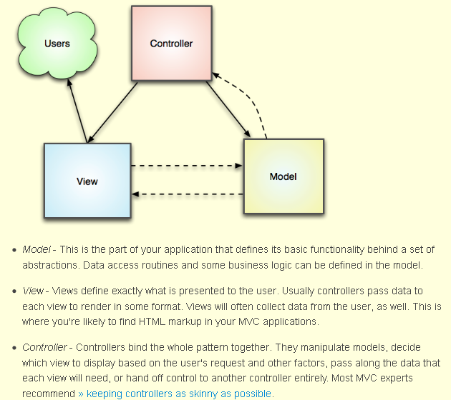
Zend
PHP 5 application framework
http://framework.zend.com/
Model-view-controller (MVC) architecture
Web services
AJAX
BSD license

Slide 28
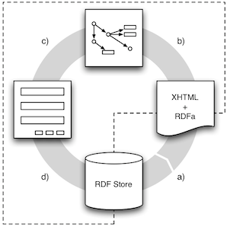
RDFauthor
Editing system for RDFa-annotated web pages
http://aksw.org/Projects/RDFauthor
☞ Note: RDFauthor, not RDFAuthor 
Page creation and delivery (a): Triples are embedded using RDFa with named graphs extension
Client-side page processing (b): Embedded triples are extracted and placed into rdfQuery databanks
Form creation (c): Based on the triples extracted, an edit form is created
Update propagation (d): Changes are sent back to the sources via SPARQL/Update
GPL license

Slide 29
Erfurt
Zend-based semantic web API
http://aksw.org/Projects/Erfurt
RDF storage abstraction
RDF parser/serializer
SPARQL 1.1 Query/Update
Versioning
Caching
GPL license

Slide 30
Virtuoso
RDF quadstore
http://virtuoso.openlinksw.com/
SPARQL 1.1
Named graphs
Full-text indexing
Inferencing
Conductor administrative interface
http://docs.openlinksw.com/virtuoso/adminui.html
GPL license

Slide 31
RDF / SPARQL
Resource Description Framework
http://www.w3.org/RDF/
Assertions of the form: subject predicate object
udfrs:u1r2473 rdfs:type udfrs:Agent .
udfrs:u1r2473 rdfs:label “C-Cube Microsystems” .
Subjects and predicates are represented by URIs; objects, by URIs or literals
Multiple serialization formats: RDF/XML, N3, N-Triples, Turtle
SPARQL Protocol and Query Language
http://www.w3.org/TR/rdf-sparql-query/

Slide 32
Noid
“Nice opaque identifier” minter
https://wiki.ucop.edu/display/Curation/NOID
Perl module
http://search.cpan.org/~jak/Noid-0.424/
Two namespaces (or “shoulders”)
“u1f” – Formats (including character encodings and compression algorithms), e.g.
“u1f378” (JPEG/JFIF 1.02)
http://udfr.org/udfr/u1f378
“u1r” – All other RDF resources, e.g.
“u1r2473” (C-Cube Microsystems)
http://udfr.org/udfr/u1r2473

Slide 33
Agenda
 | Time | Topic
✓ | 09:00 – 09.10 | Introductions and review of goals
✓ | 09:10 – 09:30 | Background on the UDFR project
✓ | 09:30 – 10:00 | Demonstration of main features
✓ | 10:00 – 10:30 | Technology stack and architecture
 | 10:30 – 10:45 | Break
 | 10:45 – 11:45 | Code walk-through
 | 11:45 – 12:00 | Questions and discussion
 | 12:00 – 13:00 | Lunch
 | 13:00 – 13:45 | Ontological models
 | 13:45 – 14:15 | Administrative procedures
 | 14:15 – 14:45 | Community building and next steps
 | 14:45 – 15:00 | Questions and discussion

Slide 34
Agenda
 | Time | Topic
✓ | 09:00 – 09.10 | Introductions and review of goals
✓ | 09:10 – 09:30 | Background on the UDFR project
✓ | 09:30 – 10:00 | Demonstration of main features
✓ | 10:00 – 10:30 | Technology stack and architecture
✓ | 10:30 – 10:45 | Break
 | 10:45 – 11:45 | Code walk-through
 | 11:45 – 12:00 | Questions and discussion
 | 12:00 – 13:00 | Lunch
 | 13:00 – 13:45 | Ontological models
 | 13:45 – 14:15 | Administrative procedures
 | 14:15 – 14:45 | Community building and next steps
 | 14:45 – 15:00 | Questions and discussion

Slide 35
Code repository
All code (and ontologies) managed in public repositories at GitHub
https://github.com/UDFR
OntoWiki
https://github.com/UDFR/OntoWiki
Forked from https://github.com/AKSW/OntoWiki
Erfurt
https://github.com/UDFR/Erfurt
Forked from https://github.com/AKSW/Erfurt
RDFauthor
https://github.com/UDFR/RDFauthor
Forked from https://github.com/AKSW/RDFauthor
All CDL development available under GPL license

Slide 36
Code review
Division of labor
New UI presentation features ⇨ modify an existing OntoWiki view or create a new extension
New UI data features ⇨ RDFauthor
Database queries and user/model authentication ⇨ Erfurt
Norman Heino, Sebastian Dietzold, Michael Martin, and Sören Auer, “Developing semantic web applications with the OntoWiki Framework,” Networked Knowledge – Networked Media 221 (Berlin: Springer, 2009), pp. 61-77 http://www.springerlink.com/content/742m6l6418887542/

Slide 37
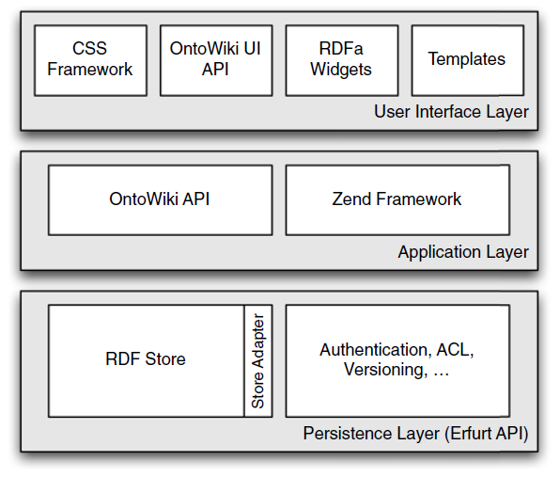
Architecture

Slide 38
MVC recap
Model
Controller
View
• Business logic
• SPARQL is here!
• Component
• Controller's methods are Actions
• OntoWiki_View class
• Templates run in
View's context

Slide 39
Request lifecycle
index.php
OntoWiki_Application
Zend Framework request dispatching
Render view
Controller

Slide 40
OntoWiki URLs
URL pattern /<controller>/<action> is automatically mapped to
<action>Action() method of the <controller>Controller class (in the file <controller>Controller.php)
Results display via the view in the file <action>.phtml

Slide 41
OntoWiki URLs
http://udfr.org/ontowiki/list/r/foaf:Person/p/2
http://udfr.org/ontowiki/resource/properties/?r=http%3A%2F%2Fudfr.org%2Fudfr%2Fu1r4396
(name or Route name)
Controller
/
Action
Parameters
r: http%3A%2F%2Fudfr.org%2Fudfr%2Fu1r4396

Slide 42
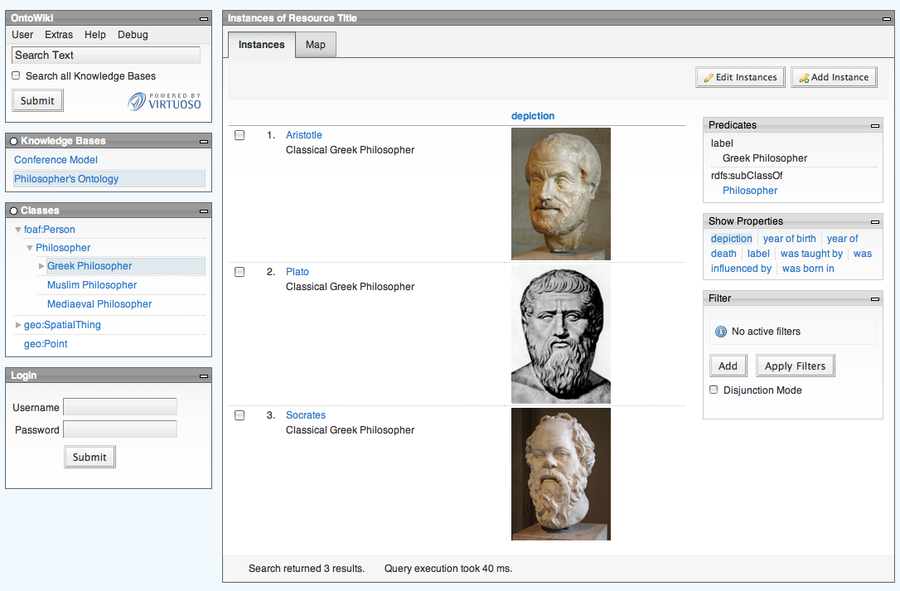
Extension types
Components
Modules
Plug-ins

Slide 43
Components
MVC controllers
Often provide view
Can serve other request
class NewController extends OntoWiki_Controller_Component {
...
}

Slide 44
Modules
Small windows
Provide additional GUI elements
class NewModule extends OntoWiki_Module
{
...
}

Slide 45
Plug-ins
Arbitrary code
Register for certain events
require_once 'OntoWiki/Plugin.php';
class NewPlugin extends OntoWiki_Plugin
{
}

Slide 46
Plug-ins
Arbitrary code
Register for certain
events
$event = new Erfurt_Event('onUpdateServiceAction');
$event->obj = $obj;
$event->trigger();

Slide 47
OntoWiki API
OntoWiki modified UI data structures
Menus
Toolbar
Navigation

Slide 48
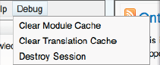
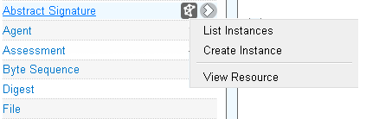
Menus
OntoWiki_Menu setEntry :: (...);
Entries may provide links, or separators
Window menu
Context menu
JSON serialization

Slide 49
Toolbar
OntoWiki_Toolbar
Default Buttons: Submit, Cancel, Edit, Add, …
UDFR button: Review
OntoWiki_Toolbar::appendButton(
OntoWiki_Toolbar::SUBMIT,
array('name' => 'Review', 'id' => 'resource-review')
);

Slide 50
Navigation
Displayed as a tab bar in the upper part of the main window
Components can register with Navigation
Can be registered:
OntoWiki_Navigation::register('history', array(
‘controller' => 'history', // history controller
'action' => 'list', // list action
'name' => 'History',
'priority' => 30)
);

Slide 51
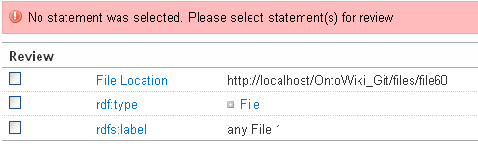
Messages
Any window can have a message
Application keeps message stack displayed
automatically in main view
Message types: success, warning, info, error
OntoWiki_Application::appendMessage(
new OntoWiki_Message(
'No statement was selected. Please select statement(s) for review', OntoWiki_Message::ERROR)
);

Slide 52
Themes
CSS, JavaScript, images, templates
Allow to modify way OntoWiki displays things
Behavior & look applied to CSS classes

Slide 53
CSS Framework
Uses generic classes
Windows
Drop-down & context menus
Tabbed content
Message boxes
Tables, lists

Slide 54
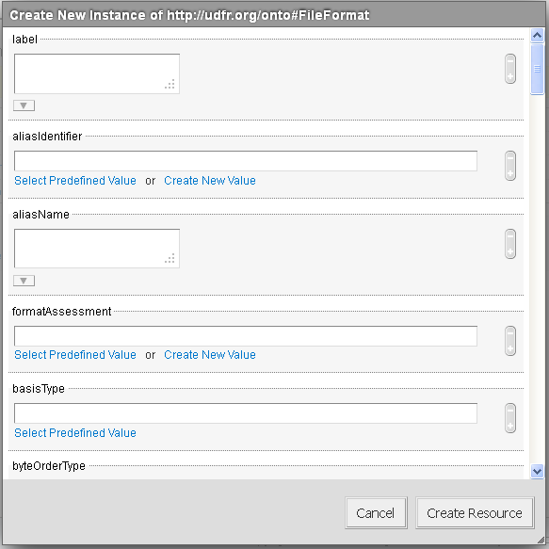
RDFa widgets
Structured data is available in rendered HTML code
Editing widgets based on extracted statements
Can probably work on more than one statement

Slide 55
Code review
UC3 modifications in three key areas
Instance creation
Review
User profile

Slide 56
Agenda
 | Time | Topic
✓ | 09:00 – 09.10 | Introductions and review of goals
✓ | 09:10 – 09:30 | Background on the UDFR project
✓ | 09:30 – 10:00 | Demonstration of main features
✓ | 10:00 – 10:30 | Technology stack and architecture
✓ | 10:30 – 10:45 | Break
✓ | 10:45 – 11:45 | Code walk-through
 | 11:45 – 12:00 | Questions and discussion
 | 12:00 – 13:00 | Lunch
 | 13:00 – 13:45 | Ontological models
 | 13:45 – 14:15 | Administrative procedures
 | 14:15 – 14:45 | Community building and next steps
 | 14:45 – 15:00 | Questions and discussion

Slide 57

Questions and discussion

Slide 58
Agenda
 | Time | Topic
✓ | 09:00 – 09.10 | Introductions and review of goals
✓ | 09:10 – 09:30 | Background on the UDFR project
✓ | 09:30 – 10:00 | Demonstration of main features
✓ | 10:00 – 10:30 | Technology stack and architecture
✓ | 10:30 – 10:45 | Break
✓ | 10:45 – 11:45 | Code walk-through
✓ | 11:45 – 12:00 | Questions and discussion
 | 12:00 – 13:00 | Lunch
 | 13:00 – 13:45 | Ontological models
 | 13:45 – 14:15 | Administrative procedures
 | 14:15 – 14:45 | Community building and next steps
 | 14:45 – 15:00 | Questions and discussion

Slide 59
Agenda
 | Time | Topic
✓ | 09:00 – 09.10 | Introductions and review of goals
✓ | 09:10 – 09:30 | Background on the UDFR project
✓ | 09:30 – 10:00 | Demonstration of main features
✓ | 10:00 – 10:30 | Technology stack and architecture
✓ | 10:30 – 10:45 | Break
✓ | 10:45 – 11:45 | Code walk-through
✓ | 11:45 – 12:00 | Questions and discussion
✓ | 12:00 – 13:00 | Lunch
 | 13:00 – 13:45 | Ontological models
 | 13:45 – 14:15 | Administrative procedures
 | 14:15 – 14:45 | Community building and next steps
 | 14:45 – 15:00 | Questions and discussion

Slide 60
Ontological Models
Overview
Purpose
Model documentation
Ontology repositories
Design decisions
Naming conventions, identifiers, URI construction
Design patterns
Additional integration
Notes:
First, I’ll discuss the models, their purpose and key stats/info about them and where they are documented
Second, I’ll review various design decisions
Third, questions? Or go through the ontologies within the tool itself?

Slide 61
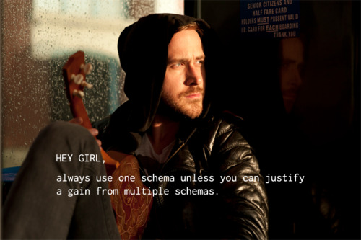
Ontological Models
Source: http://programmerryangosling.tumblr.com/post/14727789533
Notes:
First, I’ll discuss the models, their purpose and key stats/info about them and where they are documented
Second, I’ll review various design decisions
Third, questions? Or go through the ontologies within the tool itself?

Slide 62
Model Overview
System configuration and administration
Defines actions, roles, access control
Profile
Allows anonymous read-only access to public profile for provenance purposes
UDFRS/ UDFR
Defines core schema and data for registered ob jects
Imported external models
Enable semantic relationships, e.g., RDFS, OWL, SKOS
Define descriptions, e.g., DC, Dcterms
Integrate vocabularies, e.g., MADSRDF, MIME
Notes:
There are 4 sets of models.
Since UDFR is based on a semantic wiki, it is itself a model-driven application.
The system configuration models define the relationships between actions and roles
There are two ontologies – one is a schema ontology which should not be edited. This was created by AKSW.
The second is the instance data. This includes the users, roles particular to the registry and the access control.
Anytime a new user is added, they are added as a user within the configuration ontology.
If you want to create a new type of action, you would create it in the config ontology (but also need to create code to support the action)
These models also configure the access control.

Slide 63
Ontowiki Config Ontologies
OntoWiki system ontology (SysOnt)
This schema model provides the vocabulary for configuration (e.g. terms for access control).
Uses FOAF/SIOC for some profile terms
Defined by AKSW. Used for core functionality, should not be modified
OntoWiki system configuration (Config)
Imports SysOnt schema model
Used to configure model based access control (role administration)
Also used when creating new actions and mapping actions to roles

Slide 64
Configuration Concepts
User, includes special:
Anonymous (not logged in)
SuperAdmin (uses db login/pw; ignores all access control config)
Usergroup
User can be member of 1+ groups
All rights/restrictions of group are applied to User
Model, includes special:
sysont:AnyModel (any available model)
Action
Application-specific function or a group of functions identified by a URI
Developers can create new action which represents plugin capabilities
Used to manage special rights
Includes special: sysont:AnyAction (any available action)

Slide 65
Access Control
readable model
not readable model
editable model
not editable model
Action
Model
User
Usergroup
File
member
grant access
deny access
toModel
Ordering
Collect all granted models from User / Usergroup
Collect all denied models from User / Usergroup and subtract from grant list
Deny Statements override Grant Statements

Slide 66
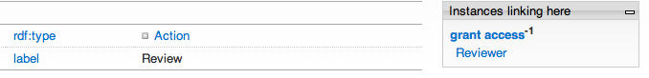
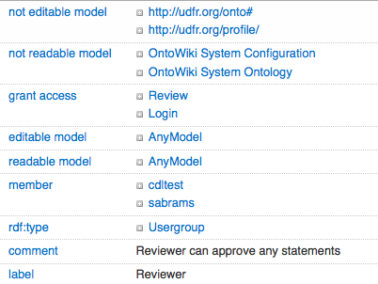
Configuration example: Review
Review Action:
Reviewer Role:

Slide 67
UDFR profile
Contains additional provenance information of users and data sources
Kept distinct from account information in Configuration model in order to display some attributes publicly
Key properties
Title
Display name
Real name
Organizational affiliation
Website
Additional notes

Slide 68
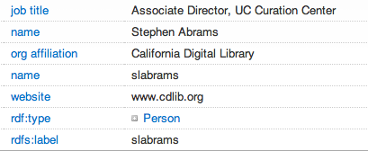
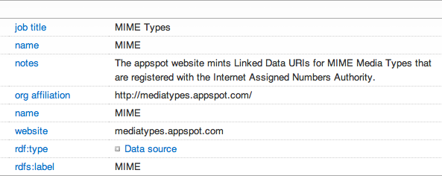
Profile example: Person
Person:
Data Source:

Slide 69
UDFR schema
Superset of PRONOM 7 and GDFR
Statistics:
5326 triples (2566 local, 2727 imported, 33 inferred)
113 classes (105 local, 8 imported)
159 properties (121 local, 38 imported)
Controlled Vocabulary classes: 38
Imported ontologies
RDF, RDFS, OWL – foundational
http://www.w3.org/1999/02/22-rdf-syntax-ns#
http://www.w3.org/2000/01/rdf-schema#
http://www.w3.org/2002/07/owl#

Slide 70
UDFR schema
Imported ontologies
FOAF, SIOC – OntoWiki foundational
http://xmlns.com/foaf/
http://rdfs.org/sioc/ns#
SKOS – controlled vocabularies
http://www.w3.org/2008/05/skos#
LOCMADS – imported LC-controlled vocabularies
http://id.loc.gov/vocabulary/iso639-2/
MIME – MIME types
http://purl.org/NET/mediatypes/

Slide 71

Code repository
Source: http://programmerryangosling.tumblr.com/post/14710787186

Slide 72
Code repository
All ontologies (and code) managed in public repositories at GitHub
https://github.com/UDFR
Ontologies
https://github.com/UDFR/UDFR-Models
udfrs [onto.owl] UDFR schema
http://udfr.org/onto#
udfr [udfr.owl] UDFR instance data
http://udfr.org/udfr/
profile [profile.owl] UDFR user profiles
http://udfr.org/profile/

Slide 73
Code repository
There are also OntoWiki system configuration schemata (only visible to administrators) (sysont/sysconf)
System Ontology
SysOnt.rdf from Erfurt include directory upon install
System Configuration
http://localhost/OntoWiki/Config/

Slide 74
Naming conventions
Classes
UpperCamelCase for URIs
TitleCase for labels
Individuals
UDFR identifiers for URIs
Data source conventions for labels
Properties
lowerCamelCase for URIs
TitleCase for labels

Slide 75
Identifiers
UDFR identifier scheme
u1f (file formats, compression algorithms, encodings)
u1r (everything else)
UDFR Local Identifier String property
Maps entity to string for easy lookup and use
Alias Identifiers
Map to resource within UDFR with:
Namespace property (e.g., PUID)
Identifier string value

Slide 76
URI Construction
Schema uses “hash” for ease of publishing
http://udfr.org/onto#
Instance data uses “slash” for ease for retrieval
http://udfr.org/udfr/

Slide 77
Design patterns
Abstract Classes
Controlled Vocabularies as closed enumeration classes / SKOS concepts
Integration with other ontologies
To enable semantic relationships (RDFS, OWL, SKOS)
To define descriptions (DC, DCTerms)
To integrate vocabularies (MADSRDF, MIME)
Implemented by:
Importing ontologies
Mapping via subClass and subProperty relations

Slide 78
Integration with PRONOM
Worked closely with UK National Archives (TNA) in ontology creation to keep joint development aligned
Potentially use owl:equivalentClass to map. However, membership of class extensions may vary
Alternatively, rdfs:subClassOf
Similar approach for properties
Define alias identifier statements in UDFR
Notes:
How does UDFR align with PRONOM vocabulary and data?
In order to provide alignment with PRONOM, we must answer:
How do we reference PRONOM schema vocabulary within the registry?
How do we instantiate existing PRONOM data within the registry?
Background
The Linked Data PRONOM Vocabulary Specification was released in Draft form on May 25, 2011. It currently has 18 classes and 16 properties. The UDFR ontology (8/31/2011) is defined by:
5326 triples (2566 local, 2727 imported, 33 inferred)
113 classes (105 local, 8 imported)
159 properties (121 local, 38 imported)
Some of the existing PRONOM classes have a direct one-to-one correspondence to UDFR classes. However, other classes within PRONOM do not exist in UDFR as UDFR has taken the modeling approach of GDFR of modeling Classifications as properties and enumerations, rather than classes.
Alignment Approaches
Following linked data principles, UDFR would reuse PRONOM schema vocabulary where appropriate. In cases where there is no UDFR counterpart, mapping could be made via equivalence relations; subProperty and subclass assertions ; or through OWL value restrictions (e.g. mapping a class to instances which have particularly defined values defined).
In addition to using the schema vocabulary, there is the instance data statements themselves.

Slide 79

UDFR schema
Source: http://programmerryangosling.tumblr.com/post/17532370461

Slide 80
UDFR schema
Abstract Base
Controlled Vocabulary
…
holder
dependency
holder
creator
Process
IPR
Agent
owner
Abstract Product
product
Holding
Digest
Abstract Signature
maintainer
reference
file
embodies
ipr
specification
digest
Software
Hardware
Media
Abstract Format
Document
File
External Signature
Internal Signature
input / output
signature
Assessment
Grammar
Character Encoding
File Format
Compression Algorithm
assessment
grammar

Slide 81
UDFR schema
udfrs:AbstractBase | Obligation | Type | Cardinality
rdfs:label | Required | xsd:string | Singleton
udfrs:aliasIdentifier | Optional | udfrs:Identifier | Repeatable
udfrs:aliasName | Optional | xsd:string | Repeatable
udfrs:description | Optional | xsd:string | Repeatable
udfrs:note | Optional | xsd:string | Repeatable
udfrs:statusType | Optional | udfrs:StatusType | Singleton
udfrs:udfrIdentifier | Required | udfrs:Identifer | Singleton

Slide 82
UDFR schema
udfrs:AbstractProduct | Obligation | Type | Cardinality
udfrs:availabilityType | Optional | udfrs:AvailabilityType | Singleton
udfrs:creationDate | Optional | xsd:string | Singleton
udfrs:dependency | Optional | udfrs:AbstractProduct | Repeatable
udfrs:disclosureType | Optional | udfrs:DisclosureType | Singleton
udfrs:documentation | Optional | udfrs:Document | Repeatable
udfrs:file | Optional | udfrs:File | Repeatable
udfrs:ipr | Optional | udfrs:IPR | Repeatable
udfrs:maintainer | Optional | udfrs:Agent | Repeatable
udfrs:owner | Optional | udfrs:Agent | Repeatable
udfrs:previousVersion | Optional | udfrs:AbstractProduct | Repeatable
udfrs:releaseDate | Optional | xsd:string | Singleton
udfrs:version | Optional | xsd:string | Singleton
udfrs:withdrawlDate | Optional | xsd:string | Singleton

Slide 83
UDFR schema
udfrs:AbstractFormat | Obligation | Type | Cardinlaity
udfrs:domainFacetType | Optional | udfrs:DomainFacetType | Repeatable
udfrs:formType | Optional | udfrs:FormType | Singleton
udfrs:formatAssessment | Optional | udfrs:Assessment | Repeatable
udfrs:genreFacetType | Optional | udfrs:GenreFacetType | Repeatable
udfrs:hasAffinityFor | Optional | udfrs:AbstractFormat | Repeatable
udfrs:isDefinedBy | Optional | udfrs:AbstractFormat | Repeatable
udfrs:isSubtypeOf | Optional | udfrs:AbstractFormat | Repeatable
udfrs:mayContain | Optional | udfrs:AbstractFormat | Repeatable
udfrs:mimeType | Optional | udfrs:MIME | Repeatable
udfrs:relatedFormat | Optional | udfrs:AbstractFormat | Repeatable
udfrs:roleFacetType | Optional | udfrs:RoleFacetType | Singleton
udfrs:signature | Optional | udfrs:AbstractSignature | Repeatable
udfrs:subsidiaryGenreFacetType | Optional | udfrs:GenreFacetType | Repeatable
udfrs:transformType | Optional | udfrs:TransformType | Repeatable

Slide 84
UDFR schema
udfrs:FileFormat | Obligation | Type | Cardinality
— | — | — | —
udfrs:Encoding | Obligation | Type | Cardinality
— | — | — | —
udfrs:Compression | Obligation | Type | Cardinality
udfrs:lossinessType | Optional | udfrs:LossinessType | Singleton

Slide 85
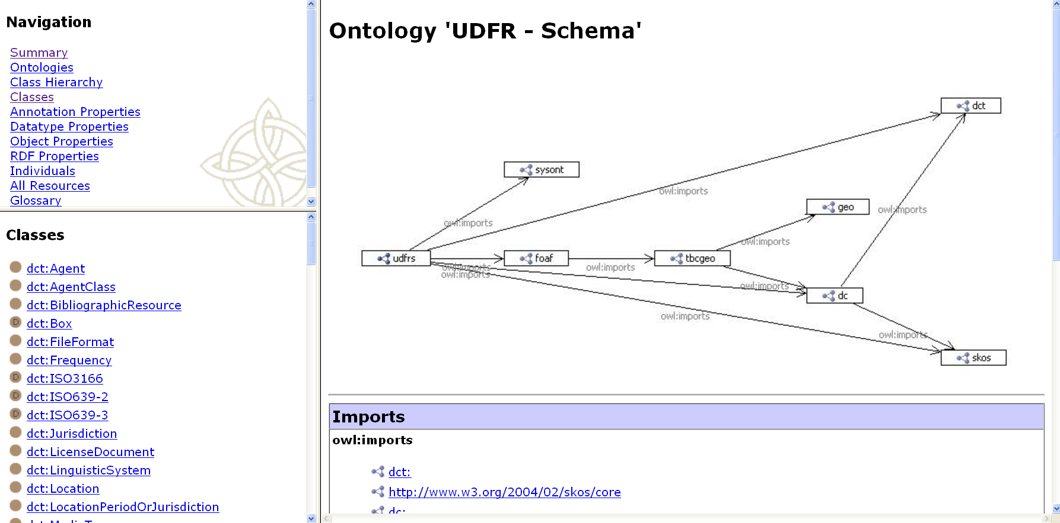
UDFR schema
Online documentation
http://udfr.org/docs/onto

Slide 86
Agenda
 | Time | Topic
✓ | 09:00 – 09.10 | Introductions and review of goals
✓ | 09:10 – 09:30 | Background on the UDFR project
✓ | 09:30 – 10:00 | Demonstration of main features
✓ | 10:00 – 10:30 | Technology stack and architecture
✓ | 10:30 – 10:45 | Break
✓ | 10:45 – 11:45 | Code walk-through
✓ | 11:45 – 12:00 | Questions and discussion
✓ | 12:00 – 13:00 | Lunch
✓ | 13:00 – 13:45 | Ontological models
 | 13:45 – 14:15 | Administrative procedures
 | 14:15 – 14:45 | Community building and next steps
 | 14:45 – 15:00 | Questions and discussion

Slide 87
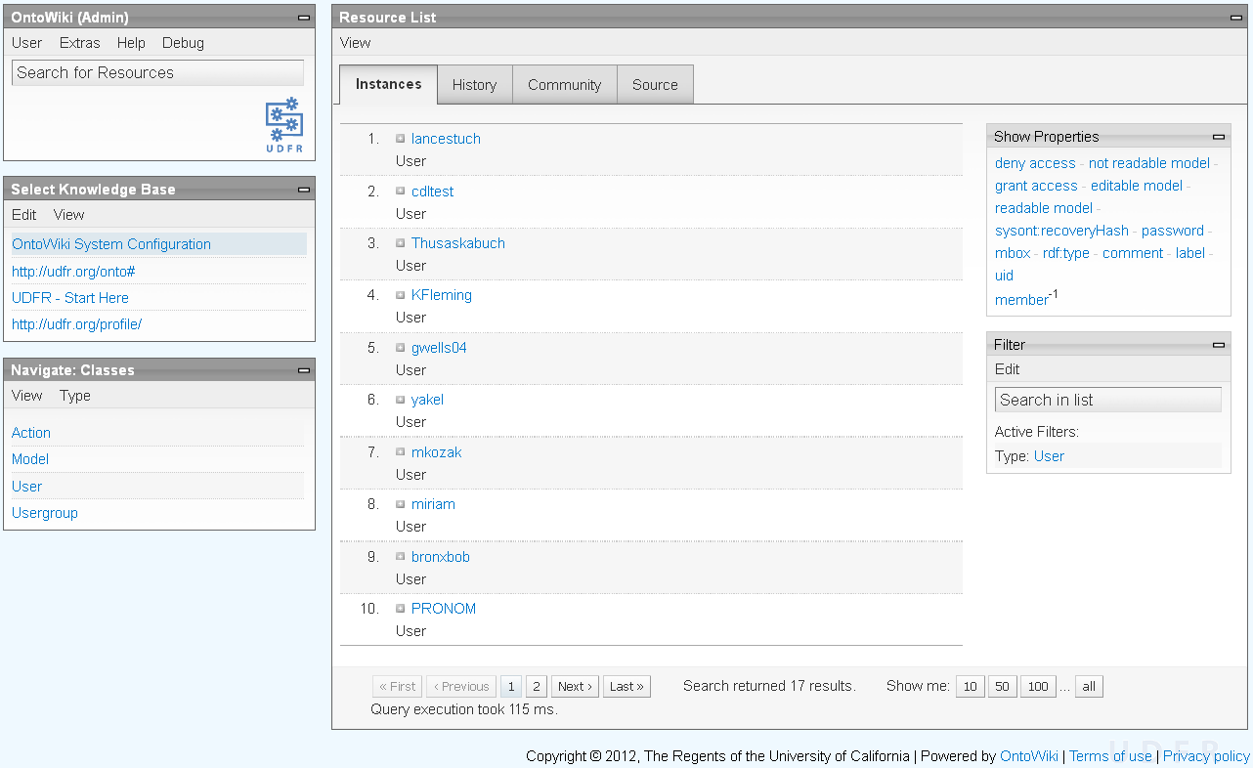
Listing all users
Login with administrative privileges
Select the “OntoWiki System Configuration” knowledge base
Select the “User” class to list all users

Slide 88
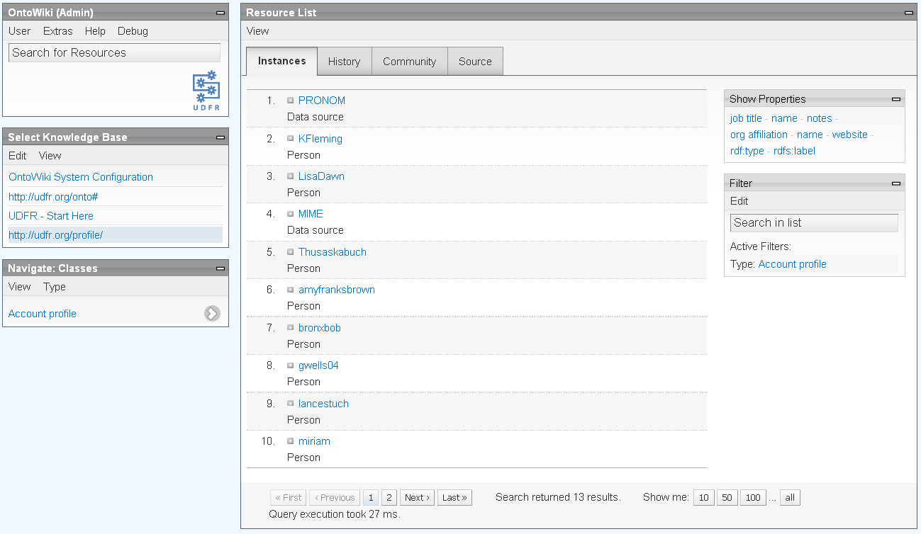
Listing user profile information
Login with administrative privileges
Select the “http://udfr.org/profile” knowledge base
Select the “Account profile” class to list all users
Select the user

Slide 89
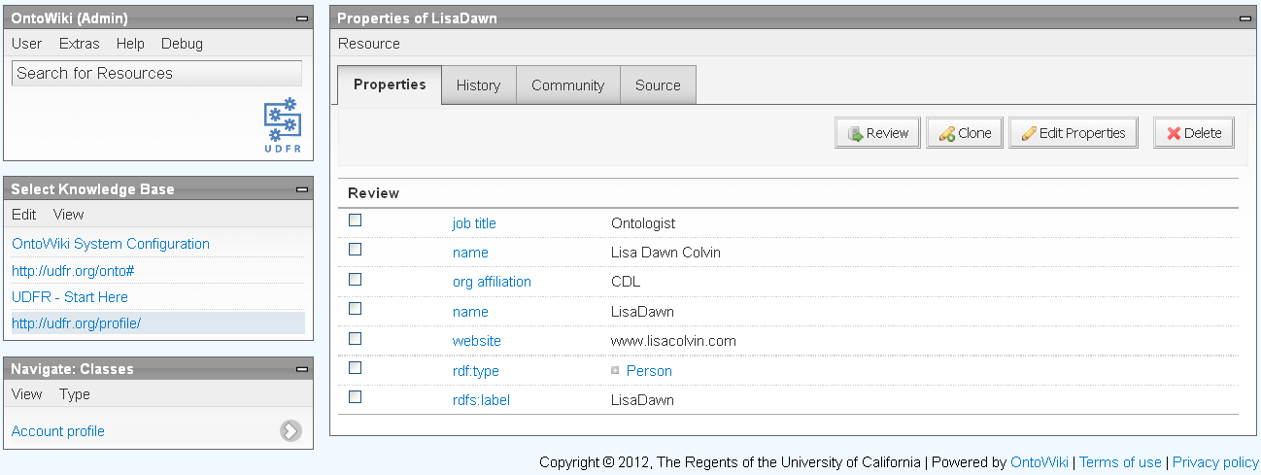
Listing user profile information
Login with administrative privileges
Select the “http://udfr.org/profile” knowledge base
Select the “Account profile” class to list all users
Select the user
Note: group membership is shown as a property of the “User” in the “OntoWiki System Configuration” knowledge base

Slide 90
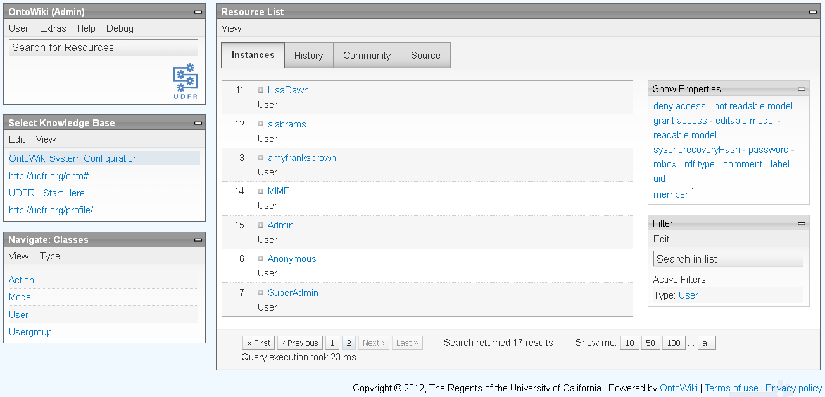
Listing user group membership
Login with administrative privileges
Select the “OntoWiki System Configuration” knowledge base
Select the “User” class to list all users
Select the user

Slide 91
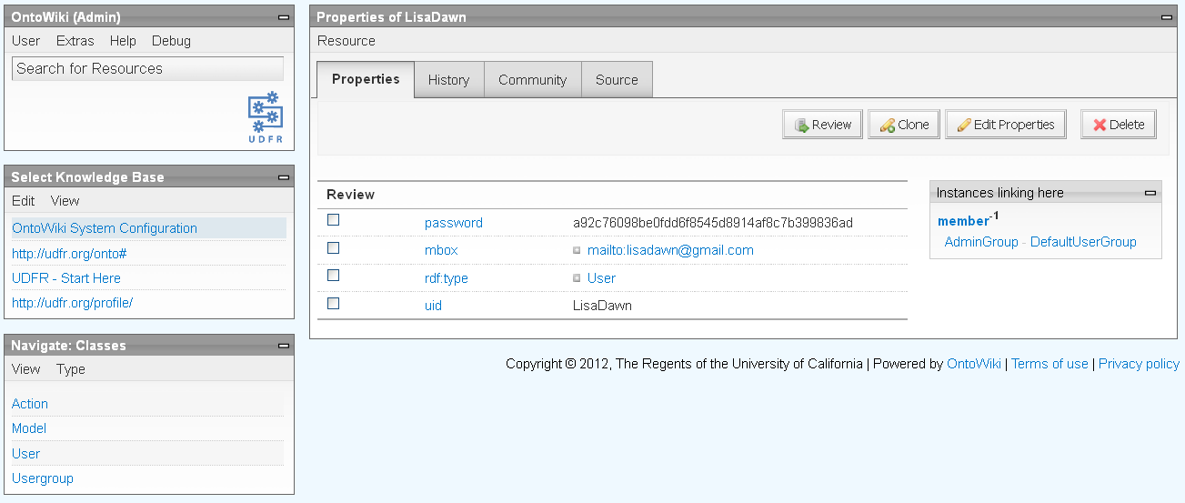
Listing user group membership
Login with administrative privileges
Select the “OntoWiki System Configuration” knowledge base
Select the “User” class to list all users
Select the user

Slide 92
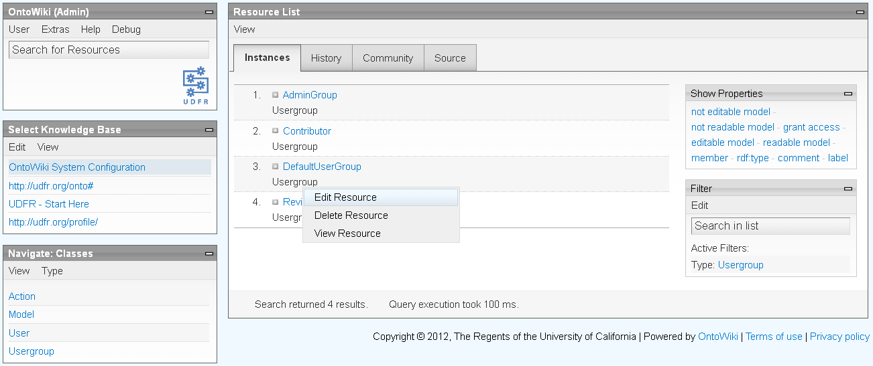
Setting user privileges
Login with administrative privileges
Select the “OntoWiki System Configuration” knowledge base
Select the “Usergroup” class to list all groups
Select “Edit Resource” in the menu for the desired group

Slide 93
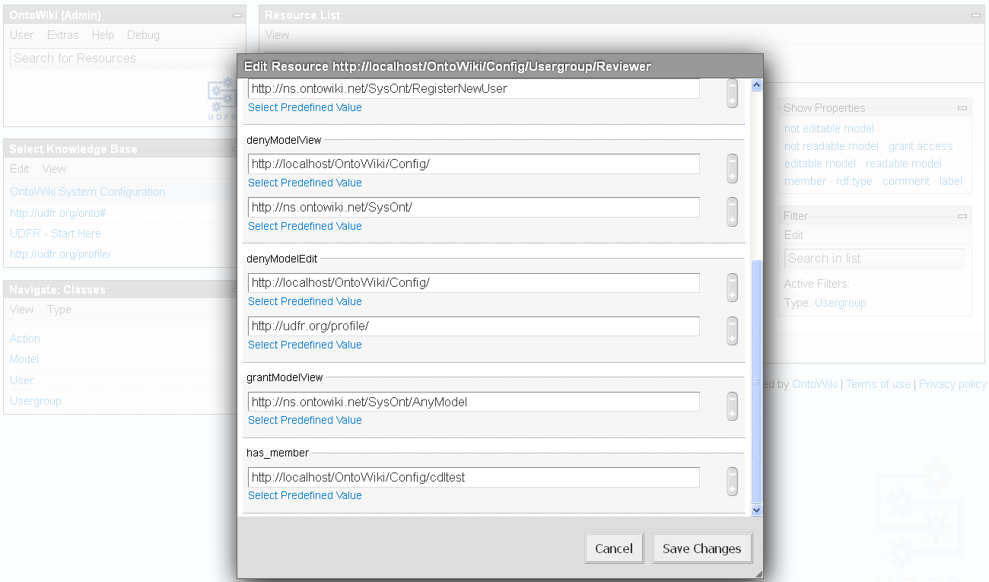
Setting user privileges
Add or delete the user as a member
User URIs are of the form” http://localhost/OntoWiki/Config/<user>

Slide 94
Reset the Noid counters
The Noid minter installation looks like:
/udfr/apps/ontowiki/minters/
u1f/
0=minter_1.00
minter.bdb
minter.lock
minter.log
minter.README
u1r/
0=minter_1.00
minter.bdb
minter.lock
minter.log
minter.README
noid/
noid*
README
...
udfrnoid.csh*

Slide 95
Reset the Noid counters
Login with role privileges
Delete or rename the “minters” directory
Run the shell script “udfrnoid.csh”
% sudo su - udfr
% cd /home/udfr/apps/ontowiki
% rm –fr minters # or mv minters minters-bak
% csh –f udfrnoid.csh init

Slide 96
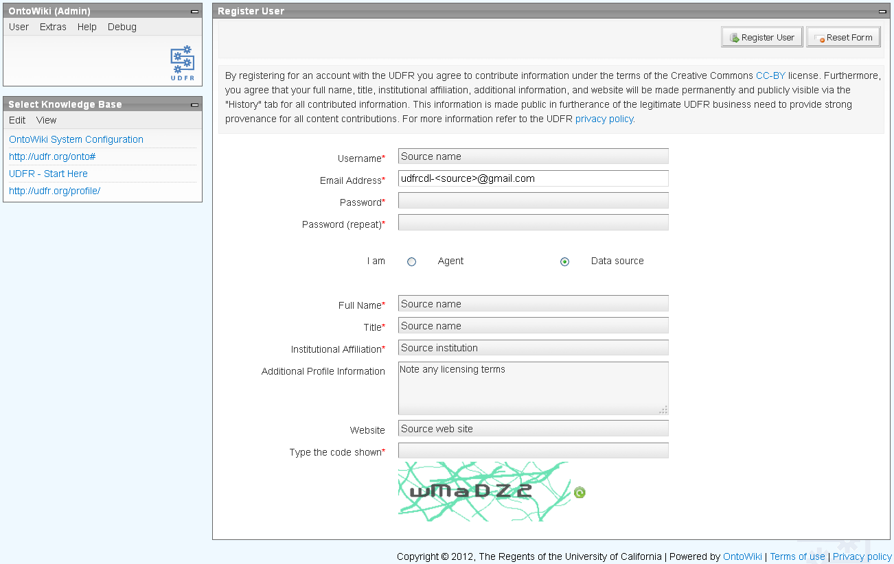
Bulk import
Create a “Data source” user
Login with administrative privileges
Select “User > Register New User” in the OntoWiki pane

Slide 97
Bulk import
Express the RDF assertions in N-Triples
http://www.w3.org/2001/sw/RDFCore/ntriples/
If adding new resources, place the “rdfs:type” assertions first
Use Noid to mint identifiers in the “u1f” and “u1r” shoulders for resource : <shoulder><id>
Use the identifiers to construct resource URIs in the “udfr” namespace: http://udfr.org/udfr/<shoulder>/<id>
This may be a multi-stage process if there are relationships between resources
udfr:u1f46 rdf:type udfrs:FileFormat .
udfr:u1f46 udfrs:udfrIdentifier “u1f46” .
udfr:u1f46 rdfs:label “Broadcast WAVE, version 0” .
...
% cd /udfr/apps/ontowiki/noid
% ./noid <shoulder>.mint 1

Slide 98
Bulk import
Submit to Virtuoso using SPARQL Update
% curl --verbose --user <user>:<password> --data-urlencode \
query@<file>.nt http://udfr.cdlib.org:8089/update

Slide 99
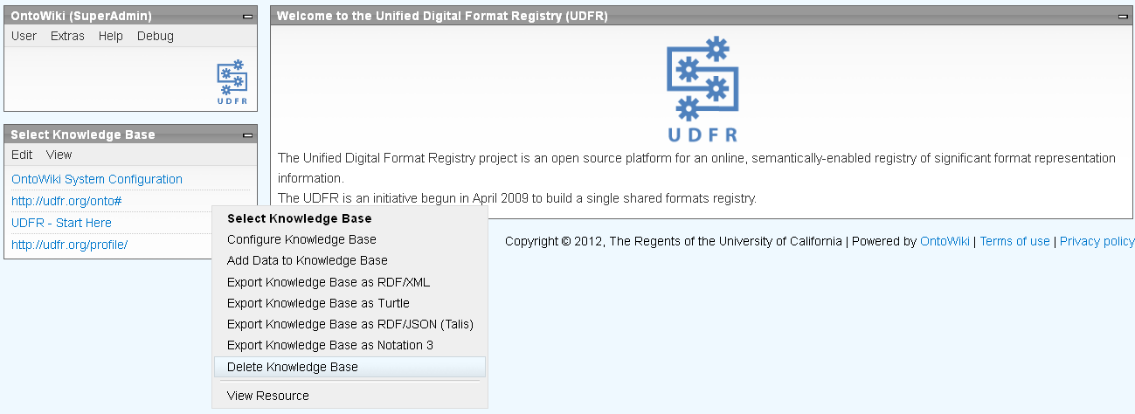
Modify an ontology
Modify the ontology using an external ontology editor
E.g., TopBraid Composer (TBC)
http://www.topquadrant.com/products/TB_Composer.html
Login with administrative privileges
Make sure there is a clean backup
Select the “Delete Knowledge Base” menu option for the relevant knowledge base

Slide 100
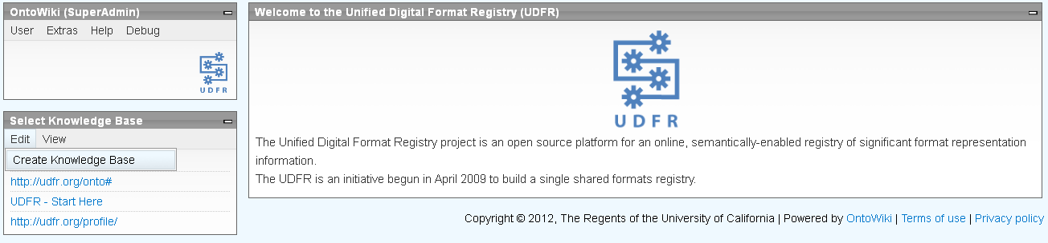
Modify an ontology
Select the “Edit > Create Knowledge Base” menu option in the “Select Knowledge Base” pane

Slide 101
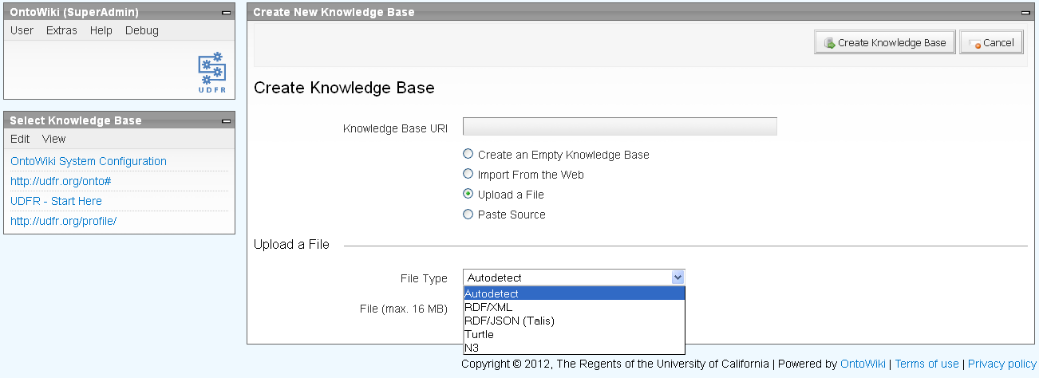
Modify an ontology
Specify the base URI
Select the “Upload a file” radio button
Select the file type

Slide 102
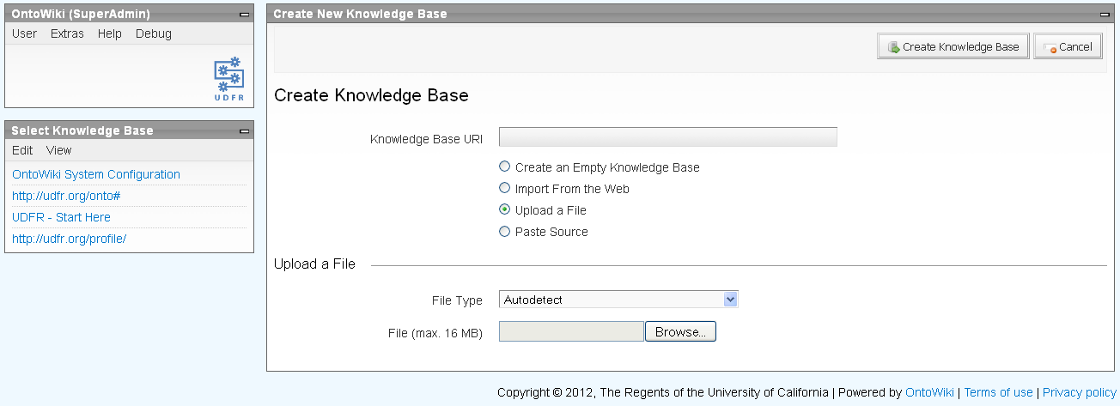
Modify an ontology
Browse to the local ontology file and upload

Slide 103
Backup
Weekly full, and nightly incremental, backups of RDF and history/provenance
Virtuoso interactive SQL utility (ISQL)
http://docs.openlinksw.com/virtuoso/backup.html
Listening on localhost:1111
% sudo su - udfr
% cd /udfr/apps/virtuoso-opensource-version/bin
% ./isql 1111 <user> <passwd>
SQL> backup_context_clear(); # leave out for nightly
SQL> checkpoint; # leave out for nightly
SQL> backup_online(‘virt-inc_dump_#’, 500, 0, vector(<directory>));
SQL> exit;

Slide 104
Restore
Shutdown Virtuoso
Delete (or rename) Virtuoso database file
Restart Virtuoso
Replay transaction file(s)
% sudo su – udfr
% cd /udfr/apps/virtuoso-opensource-version/var/lib/virtuoso/db
% rm –f virtuoso.db
% cd /udfr/apps/virtuoso-opensource-version/bin
% ./virtuoso-t –c ../var/lib/virtuoso/ontowiki/virtuoso.ini \
+restore-backup virt-inc_dump_#
% ./isql 1111 <user> <passwd>
SQL> replay(‘<transaction-file-1>’); # specify files in temporal order
SQL> replay(‘<transaction-file-2>’);
SQL> ...
SQL> exit;

Slide 105
Agenda
 | Time | Topic
✓ | 09:00 – 09.10 | Introductions and review of goals
✓ | 09:10 – 09:30 | Background on the UDFR project
✓ | 09:30 – 10:00 | Demonstration of main features
✓ | 10:00 – 10:30 | Technology stack and architecture
✓ | 10:30 – 10:45 | Break
✓ | 10:45 – 11:45 | Code walk-through
✓ | 11:45 – 12:00 | Questions and discussion
✓ | 12:00 – 13:00 | Lunch
✓ | 13:00 – 13:45 | Ontological models
✓ | 13:45 – 14:15 | Administrative procedures
 | 14:15 – 14:45 | Community building and next steps
 | 14:45 – 15:00 | Questions and discussion

Slide 106
To do
Peer-to-peer replication
Import additional data sources
Library of Congress Sustainability of Digital Formats
http://www.digitalpreservation.gov/formats/
Other candidates?
Recruit reviewers
Permanent operational home
Sustainable community governance and development/ maintanence structure

Slide 107
Agenda
 | Time | Topic
✓ | 09:00 – 09.10 | Introductions and review of goals
✓ | 09:10 – 09:30 | Background on the UDFR project
✓ | 09:30 – 10:00 | Demonstration of main features
✓ | 10:00 – 10:30 | Technology stack and architecture
✓ | 10:30 – 10:45 | Break
✓ | 10:45 – 11:45 | Code walk-through
✓ | 11:45 – 12:00 | Questions and discussion
✓ | 12:00 – 13:00 | Lunch
✓ | 13:00 – 13:45 | Ontological models
✓ | 13:45 – 14:15 | Administrative procedures
✓ | 14:15 – 14:45 | Community building and next steps
 | 14:45 – 15:00 | Questions and discussion

Slide 108
Questions and discussion

Slide 109
For more information
UDFR
http://udfr.org/
http://bitbucket.org/udfr
http://github.com/UDFR
udfr-l@listserv.ucop.edu
OntoWiki
http://ontowiki.net/Projects/OntoWiki
Erfurt
http://aksw.org/Projects/Erfurt
RDFauthor
http://aksw.org/Projects/RDFauthor
Zend
http://framework.zend.com/
Virtuoso
http://www.openlinksw.com/dataspace/dav/wiki/Main/VOSRDFWP
AKSW, Universität Leipzig
http://aksw.org/
Philipp Frischmuth Norman Heino
Sebastian Tramp
Library of Congress
http://www.digitalpreservation.gov
Martha Anderson Leslie Johnston
UC Curation Center
http://www.cdlib.org/uc3
uc3@ucop.edu
Stephen Abrams Lisa Dawn Colvin
Patricia Cruse John Kunze
Margaret Low Mark Reyes
Abhishek Salve Marisa Strong

